Slide 1
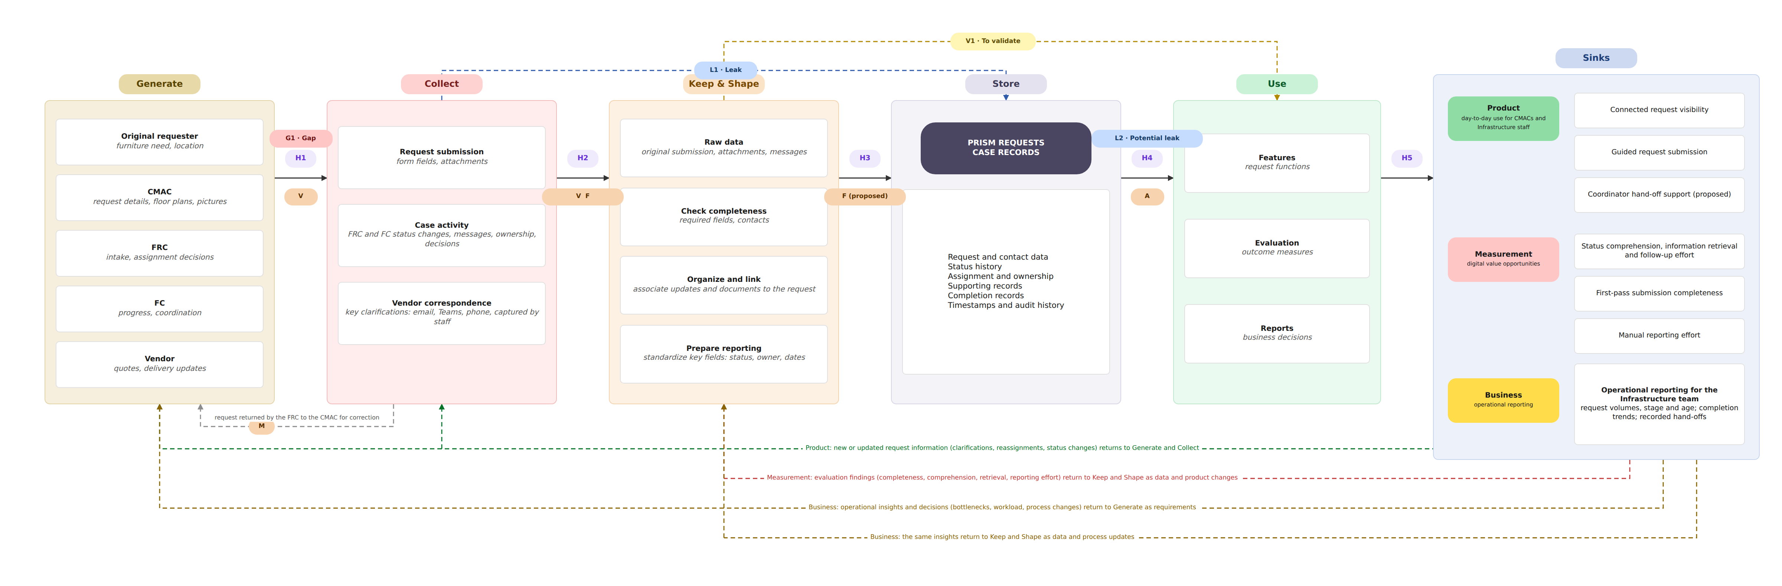
End-to-End Data Pipeline
STEP TWO | MAP THE PIPELINE END TO END
Miro board, pipeline frame: https://miro.com/app/board/uXjVETT1rZQ=/?moveToWidget=3458764689186375182
One request, traced through the stages: a CMAC asks for 14 additional task chairs, recycled or new, for staff on the 2nd floor of McDougall Centre (the request tested in usability Task 1).
Also on the frame: the hand-off legend H1 to H5 with the data moved and flow frequency; the identified gaps and leaks G1, L1, L2 and V1 with the response to each; and the control key, where authentication, validation, flow monitoring and mitigation are placed at the hand-offs they apply to, and an alarm is not included because there is no defined trigger or recipient yet.
Notes:
This is our pipeline in Miro. Each stage shows what happens to the data there: Generate lists the five creators and what each contributes; Collect holds the request submission, case activity and vendor correspondence; Keep and Shape holds the raw data, the completeness check, organizing and linking, and preparing reporting; Store is the PRISM Requests case record; Use holds features, evaluation and reports, which feed the three sinks. Hand-offs are labelled H1 to H5 with the data each moves and how often, feedback loops run from the sinks back into the stages, findings G1, L1, L2 and V1 are marked where they occur, and controls sit at the hand-offs they apply to. Our focus is CMAC visibility across the Furniture Request lifecycle (slide 1).
We trace one request from usability Task 1: a CMAC asks for 14 task chairs, recycled or new, for staff on the 2nd floor of McDougall Centre.
Generate. The furniture need and location are born with the original requester. The CMAC adds the request details, floor plans and pictures; the Furniture Request Coordinator adds intake and assignment decisions; the Furniture Coordinator adds progress and coordination; and the vendor adds quotes and delivery updates. H1 moves the request details and attachments into Collect; it is event-driven and intermittent, one request at a time.
Collect. Three streams are captured: the request submission through the guided form, its fields and attachments; case activity, meaning FRC and FC status changes, messages, ownership and decisions; and vendor correspondence, the key clarifications from email, Teams and phone captured by staff. Finding G1 sits on this hand-off: required plans, dimensions and supporting documents may be missing or unreliable, and the response is to clarify submission requirements and review responsibility (slide 9). H2 moves submitted forms and case updates onward as they happen.
Keep and Shape. The raw data, the original submission with its attachments and messages, is kept unchanged. Completeness is checked against required fields and contacts; updates and documents are organized and linked to the request; and reporting is prepared by standardizing key fields such as status, owner and dates. A request that falls short is returned by the FRC to the CMAC for correction, the mitigation step on the diagram. H3 moves structured case data and linked documents into Store; making this event-driven is proposed.
Store. One case record holds the request and contact data, the status history, assignment and ownership, supporting records, completion records, and timestamps and audit history. Finding L1 sits between Collect and Store: updates and decisions are distributed across email, Teams and phone and do not all reach the record, and the response is to define which updates must be linked to the request and who records them (slide 9).
Use. Case records and history are read on demand, H4, into three uses: features, the request functions; evaluation, the outcome measures; and reports for business decisions. H5 carries features, evaluation evidence and reporting data to the sinks at a frequency that varies by sink. The product sink serves day-to-day use for CMACs and Infrastructure staff: connected request visibility, guided request submission and coordinator hand-off support, which remains proposed. The measurement sink holds the digital value opportunities: status comprehension, information retrieval and follow-up effort; first-pass submission completeness; and manual reporting effort. The business sink is operational reporting for the Infrastructure team: request volumes, stage and age, completion trends and recorded hand-offs. Two findings sit on this side: L2, previously supplied information may not reach the next responsible person, answered by validating contact purposes and hand-off responsibilities; and V1, measurement readiness, where event coverage, meanings and access are not verified, answered by inspecting existing records and phasing reporting accordingly (slide 9).
Feedback loops. Using the service creates data that flows back in. From the product sink, new or updated request information, clarifications, reassignments and status changes, returns to Generate and Collect. From the measurement sink, evaluation findings on completeness, comprehension, retrieval and reporting effort return to Keep and Shape as data and product changes. From the business sink, operational insights and decisions on bottlenecks, workload and process changes return to Generate as requirements and to Keep and Shape as data and process updates (slide 8).
Controls. Controls are placed where they apply, not everywhere. Authentication verifies authorized access to PRISM requests and system access for the CMAC, FRC, FC and Infrastructure, at Store to Use. Validation checks required fields, attachments and data format at intake, Generate to Collect, and at the FRC review, Collect to Keep and Shape. Flow monitoring tracks submission and update flow, delays and incomplete records, from Collect through Keep and Shape to Store; it is proposed. Mitigation corrects or flags issues, for example a request returned for more information or attachment rework. An alarm is not included because there is no defined trigger or recipient yet. Anything not yet agreed is marked to confirm with the client.

Slide 2
Pipeline Stages, Owners, Preparation and Constraints
STEP TWO | MAP THE PIPELINE END TO END
Stage | Owner | Preparation: what it must achieve | Constraints
1 Generate | Whoever enters the information answers for it: the original requester, the CMAC, the coordinators and the vendor; PRISM Requests answers for the events it records | None: data is created here, so it must be captured where the work happens | Intermittent, one request at a time; much is born in email, Teams and phone; floor plans may not be current, and a form can confirm a plan is attached but not that it is accurate
2 Collect | CMAC, for the details submitted; authorized staff, for the email and vendor information they capture or link | Request submission through the guided form, fields and attachments; case activity: status changes, messages, ownership, decisions; vendor correspondence captured by staff | Data arrives as requests and updates happen, not on a schedule; attachment size limits are to be confirmed; updates outside the service are lost unless staff capture or link them, which takes recording effort
3 Keep and Shape | To confirm with the client; we suggest the Furniture Request Coordinator | Keep the raw data unchanged; check completeness against required fields and contacts; organize and link updates and documents to the request; prepare reporting by standardizing key fields such as status, owner and dates | Status meanings and completion criteria are not yet confirmed with the business; there is no agreed rule yet for matching duplicate requests; some requirements are typed as free text in comments rather than set fields
4 Store | A named data owner, to confirm with the client | One case record: request and contact data, status history, assignment and ownership, supporting records, completion records, timestamps and audit history; the submitted request never overwritten | Retention requirements to confirm; historical WORTS migration is outside the current proposal
5 Use | Data owner, for what the views show; report owners to confirm with the client | Features, the request functions; evaluation, the outcome measures; and reports for business decisions read the case records and history on demand; only substantiated communication outcomes shown | Who may view, update or share each item is to be confirmed; we suggest a CMAC sees only their own requests; report freshness to confirm
What clean, trusted data means here
Suggested rules, to confirm with the business
One Request ID, with every material update linked to it
One status from an agreed list, with a defined meaning
The current responsible role or group identified at every stage
The information needed for the next step present before review
Dates in one format and in true order
Duplicate requests checked on an agreed match key
A request that fails the completeness check, the six rules, returns to the CMAC with what is missing, then is reviewed again.
Clean is a product decision; the method is not specified.
Anything not yet agreed is marked to confirm with the client.
Notes:
This slide answers three questions for each stage: who is responsible, what preparation must achieve, and which constraints apply. We state what preparation must achieve, not how it is engineered.
Ownership. Every stage has an owner, but entering data is not the same as being accountable for its accuracy. By creators we mean the people who enter information: the original requester, the CMAC, the Furniture Request Coordinator, the Furniture Coordinator and the vendor. Each answers for what they provide. The stage owner is the role accountable for the rules at that stage, for example whoever runs the completeness check at Keep and Shape. The data owner answers for the request record from start to finish, including access and retention. Staff who capture or link email and vendor information take on recording effort that needs to be planned (slide 10). Two owners still need the client's confirmation: for Keep and Shape we suggest the Furniture Request Coordinator, who already reviews requests and decides whether they are complete enough to act on, and a data owner must be named for the stored record.
Preparation. We keep the request exactly as the CMAC submitted it, then shape one trusted version from it. The six rules on the right define what clean means for this service: a consistent Request ID, agreed status definitions, the current responsible role or group, the information needed for the next step, dates in true order, and a duplicate check. They are suggestions: status meanings, completion criteria and the duplicate match rule still need the business's confirmation (slide 10). A completeness check confirms that information is present, not that it is accurate, so the coordinator's professional judgement remains part of the review.
Constraints. Frequency: requests are human-generated and intermittent, one at a time. Format: needs arrive by email, Teams and phone, and floor plans may not be current (slide 9). Quality: status definitions are not yet agreed, and some requirements are typed as free text in comments rather than set fields. Access: who may view, update or share each item is still to be confirmed; we suggest that a CMAC sees only their own requests. Communication: the service should show only outcomes it can substantiate. Retention: requirements are to be confirmed, and historical WORTS migration is outside our current proposal; any future migration needs client confirmation (slide 3).
Why this matters for the PRD and Milestone 3. Each owner, rule and access decision still to be confirmed becomes a requirement to confirm in the PRD, not an assumption built into the design. Together they define what trusted current and historical data must look like before any storage or architecture decision is made in Milestone 3.

